Slide 1
LAN, WAN, MAN & ETHERNET
Group 3
SHREYASH BHATKAR 41

Slide 2
CONTENTS
Introduction
LAN
Types of LAN Hardware
WAN( Wide-area network)
MAN (Metropolitan area network)
Ethernet LANs
Types of Ethernet LANs
Advanced Ethernet
Advantage – Disadvantages
References

Slide 3
INTRODUCTION
A LAN is, as the name implies, a local network.
This network could be as small as two computers that are connected to each other or large, with thousands of devices connected.
Small LANs can be used by a company to interconnect several offices in the same building
Eg:- Wiring between different floors of the building to make the connection
Larger LANs can interconnect several buildings within a complex
Eg:- Large companies with multiple buildings, military installations, and college campuses
Home networks of two or more PCs are also LANs, and today most home LANs are fully wireless or incorporate wireless segments.

Slide 4
LAN HARDWARE
All LANs are a combination of hardware and software. The primary hardware devices are the computers themselves and the cables and connectors that link them.
Types of LAN Hardware:-
Cables
Connectors
Repeaters
Hubs
Bridges
Switches
Routers

Slide 5
CABLES
The digital data stored in the computer is converted to serial binary data, and voltages representing binary 1s and 0s are transmitted directly over the cable from one computer to another.
Types of Cables:-
CHARACTERISTICS | TWISTED PAIR CABLE | CO-AXIAL CABLE | OPTICAL FIBER CABLE
Signal transmission | Takes place in the electrical form over the metallic conducting wires. | Takes place in the electrical form over the inner conductor of cable. | Takes place in an optical form over a glass fiber.
Bandwidth | Twisted pair cable has low bandwidth. | Co-axial cable has moderately high bandwidth. | Optical fiber cable has very high bandwidth.
Data rate | Twisted pair cable supports low data rate. | Moderately high data rate. | Very high data rate.
Applications | Telephone lines to provide voice and data channels. | Ethernet connections, digital audio(S/PDIF),and distribution of cable television signals. | Transmit telephone signals, internet communication and cable television signals.

Slide 6
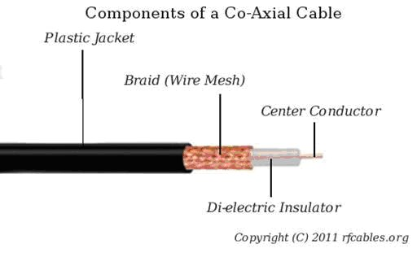
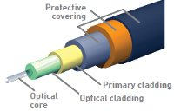
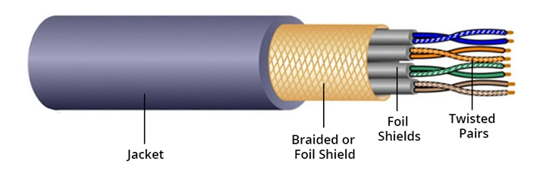
Components of Co-Axial cables
Components of Fiber-Optics cables
Components of Twisted Pairs cables

Slide 7
CONNECTORS
A connector is a device that terminates a segment of cabling or provides a point of entry for networking devices.
Types of Connectors:-
=Coaxial Cable Connectors:-
Coaxial cable connectors are used to connect cables to other devices and are specifically designed to maintain the shielding on the cable.
=Twisted-Pair Connectors:-
Most telephones attach to an outlet by way of an RJ-11 connector or modular plug . RJ-11 connectors are used to connect PC modems to the phone line but are not used in LAN connections.
=Fiber-Optic Connectors:-
A wide range of connectors are available to terminate fiber-optic cables. Like electrical connectors, these are designed to provide a fast and easy way to attach or remove cables.

Slide 8
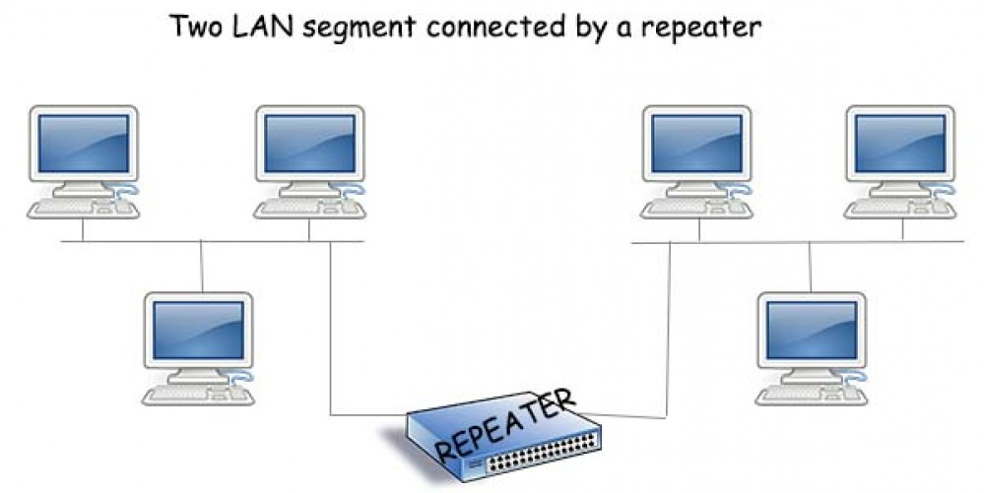
REPEATERS
Repeater: an electronic device that receives a signal and retransmits it at a higher level or higher power, or onto the other side of an obstruction, so that the signal can cover longer distances.
Repeaters are small, inexpensive devices that can be inserted into a line with appropriate connectors or built into other LAN equipment.
Most repeaters are really transceivers bidirectional circuits that can both send and receive data.
Transceiver repeaters can receive signals from either direction and transmit them in the opposite direction.

Slide 9
HUBS
A hub is a LAN accessory that facilitates the interconnections of the cables to the nodes.
Hubs are usually active devices containing repeaters. Hubs amplify and reshape the signal and transmit it to all connection parts.
Hubs are available with 8, 12, 16, 24, 32,and 48 ports. All signals received at the hub are repeated to all nodes connected to the hub.

Slide 10
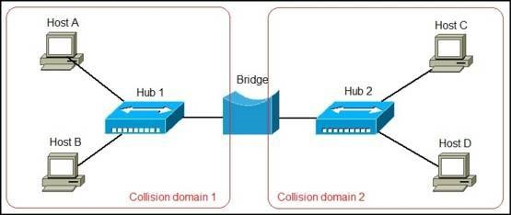
BRIDGES
A bridge is a network device that is connected as a node on the network and performs bidirectional communication between two LANs with same protocol.
However, there are bridges that are able to accomplish protocol conversion so that two LANs with different protocols can converse.
A bridge can use the telephone network to connect LANs in two different parts of the country, or can connect two LANs on a large campus or the grounds of a big military base through a fiber-optic cable or wireless connection.

Slide 11
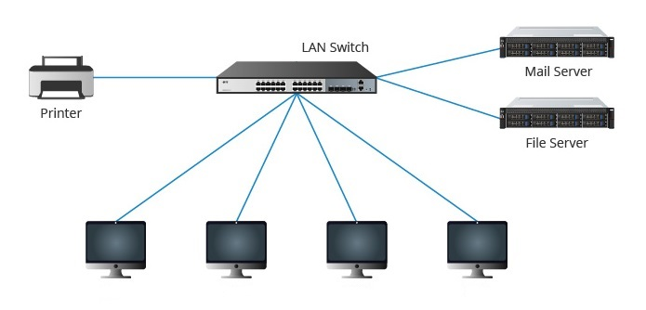
SWITCHES
A switch is a device that connects devices together on a computer network, by using packet switching to receive, process and forward data to the destination device.
Unlike less advanced network hubs, a network switch forwards data only to one or multiple devices that need to receive it, rather than broadcasting the same data out of each of its ports.
Fig:-An Ethernet switch speeds up the network and provides security.

Slide 12
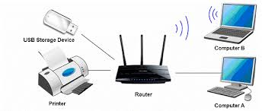
ROUTERS
A networking device that forwards data packets between computer networks. Routers perform the "traffic directing" functions on the internet. A data packet is typically forwarded from one router to another through the networks that constitute the internetwork until it reaches its destination node.
Like bridges, routers are designed to connect two networks. The main difference between bridges and routers is that routers are intelligent devices that have decision-making and switching capabilities.

Slide 13
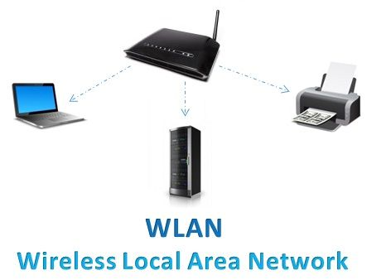
WIRELESS LANs
A wireless LAN (WLAN) is a wireless computer network that links two or more devices using wireless communication to form a local area network (LAN) within a limited area such as a home, school, computer laboratory, campus, or office building.
This gives users the ability to move around within the area and remain connected to the network.
One of the most complex and expensive parts of any LAN is the cabling which can be avoided using WLAN.

Slide 14
WAN( Wide-area network)
What is a WAN?
A WAN is a network that uses various links—private lines, Multiprotocol Label Switching (MPLS), virtual private networks (VPNs), wireless (cellular), the Internet—to connect smaller metropolitan and campus networks in diverse locations into a single, distributed network.
The sites they connect could be a few miles apart or halfway around the globe.

Slide 15
WANs vs. LANs: What’s the difference?
LANs are networks generally limited to a single building or small campus. They’re private to a single organization or even person and can be created with relatively inexpensive equipment. Your home Wi-Fi network is a LAN.
The technologies and protocols that make LANs easy to set up don’t scale beyond a certain limited distance or to truly massive numbers of endpoints. Dealing with those scales is the purpose of a WAN: connecting one or more LANs.

Slide 16
WAN Architecture
While LANs are usually maintained by an organization’s own IT staff, WANs are often at least in part reliant on physical connections provided by telecommunications carriers.
Decisions on what kind of connections or communications protocols to use and how to deploy them will guide the creation of your WAN architecture.

Slide 17
WAN Protocols
X.25 -
One of the earliest protocols used to deliver WAN traffic is X.25, which uses packet-switching exchanges (PSE) for the hardware that drops traffic onto the wires connecting sites. It includes standard-sized packets delivered in order and includes error correction.
Frame relay -
Frame relay is a successor to X.25. Frame relay cuts data into different-sized frames and leaves error correction and retransmission of missing packets up to the endpoints. These differences speed up the overall data rate.
ATM -
Asynchronous Transfer Mode (ATM) is similar to frame relay with one big difference: data is broken into standard-sized packets called cells.

Slide 18
WAN Protocols
MPLS - Today, multi-protocol label switching is used to carry much corporate data across WAN links. Within an MPLS network, brief header segments called labels allow MPLS routers to decide quickly where to forward packets and to treat them with the class of service indicated by the labels.
IP - Internet protocol (IP), which became more ubiquitous in the 1990s, is one protocol commonly carried within MPLS.

Slide 19
Metropolitan area network (MAN)
What is a metropolitan area network (MAN)?
A metropolitan area network (MAN) is a computer network that connects computers within a metropolitan area, which could be a single large city, multiple cities and towns, or any given large area with multiple buildings. A MAN is larger than a local area network (LAN) but smaller than a wide area network (WAN).

Slide 20
How are MAN networks constructed?
Like WANs, a MAN is made up of interconnected LANs. Because MANs are smaller, they are usually more efficient than WANs, since data does not have to travel over large distances.
Most MANs use fiber optic cables to form connections between LANs. Often a MAN will run on "dark fiber" — formerly unused fiber optic cables that are able to carry traffic.

Slide 21
How Does a Metropolitan Area Network Work?
The network is established using routers and switches. A switch is a port which is active in handling the filtration of data usually coming in the form of frames. Any switch acts as a dual-port, at one end it is handling filtration of data and at the other end managing connections.
The router is another device for facilitating the network connection. A router helps the data packets to identify the path to be taken. Hence, in other words, it keeps an eye on the data transfer. MAN (Metropolitan Area Network) is usually operated over an area of up to 5 to 50kms.

Slide 22
Characteristics of MAN
Network size generally ranges from 5 to 50 km. It may be as small as a group of buildings on campus to as large as covering the whole city.
In general, a MAN is either owned by a user group or by a network provider who sells service to users, rather than a single organization as in LAN.
Data rates are moderate to high.
It facilitates the sharing of regional resources.
They provide uplinks for connecting LANs to WANs and the Internet.

Slide 23
Ethernet LANs
Ethernet is a way of connecting computers together in a local area network or LAN
It was developed by Xerox Corporation at Palo Alto Research Centre in 1970, commercially introduced in 1980 and standardized as IEEE 802.3 in 1983
It has been most widely used method of linking computers together in LAN

Slide 24
Data Transmission
Ethernet connection transmits data over cables.
Cables can be Co-axial, Twisted Pair or Optical fibers.
Ethernet uses baseband transmission method in which digital signals are transmitted like train of pulses.
In previous versions of Ethernet ‘bus topology’ (all the nodes are collected to single cable) was used, but now-a-days physical star configuration (all the nodes are connected individually) is in demand.

Slide 25
Access Method
Access method refers to the protocol used for transmitting and receiving information on a bus
Ethernet uses Carrier sense multiple access method with collision detection (CSMA/CD) which verifies the absence of other traffic before transmitting on a shared medium
Collision detection enables stations to detect collisions, so they know when they must transmit

Slide 26
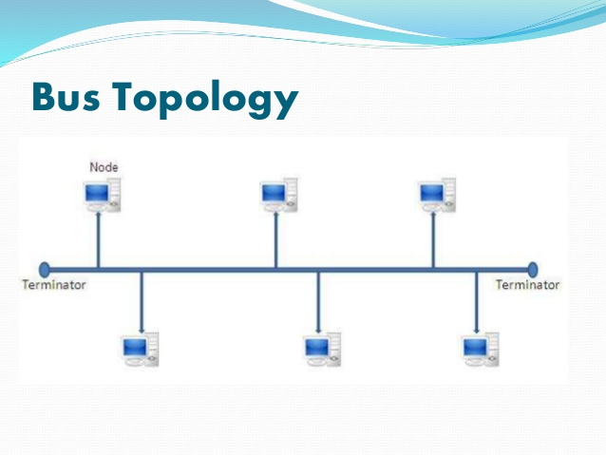
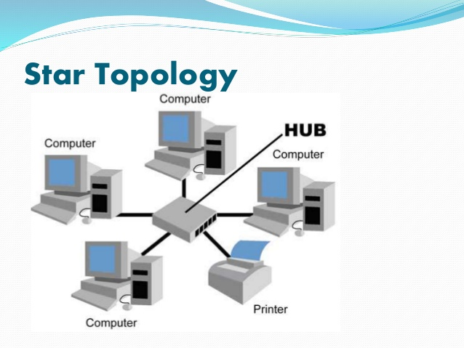
Data Transmission
Bus Topology
Physical Star Configuration

Slide 27
Types of Ethernet LANs
Standard Ethernet:-
transmits data with the speed up to10Mbps
Manchester encoding is used in it
Fast Ethernet:-
transmits data with the speed up to 100Mbps
MLT-3 encoding method is used in it
Versions: 100Base-T, 100BaseTX, 100VG-AnyLAN and 100Base-T4 use Twisted Pair Cable and 100BaseFX uses Fiber-Optic Cable

Slide 28
Types of Ethernet LANs
Gigabit Ethernet:-
Transmits data with the speed up to 1Gbps
Mostly uses Fiber Optic cable for transmission
versions: 1000Base-T (Twisted pair cable)
1000Base-LX(Single-mode fiber)
1000Base-SX(Multi-mode fiber)
All fiber optic versions of Gigabit Ethernet uses 8B/10B encoding
Ten Gigabit Ethernet:-
Transmits data with the speed up to 10Gbps
The UTP version is referred as 1000Base-T

Slide 29
Advanced Ethernet
40Gbps and 100Gbps Ethernet:-
40GE/100GE version of Ethernet was established in 2010 as IEEE 802.3ba
This can also be used in WANs, MANs, data centers and equipment backplanes along with LANs
Mostly Fiber optic Cables are used
Versions: 40Gbps = 40GBASE-KR4, 40GBASE-CR4,
40GBASE-SR4, 40GBASE-T, etc
100Gbps = 100GBASE-KP4, 100GBASE-KR4, 100GBASE-CR10, 100GBASE-SR10, etc

Slide 30
Advantages & Disadvantages
Advantages:-
Relatively low cost
Generally resistant to noise
Good data transfer quality
Good data security
Reliability and efficiency
Disadvantages:-
Smaller and shorter distance networks
Mobility is limited
Increased traffic makes the Ethernet speed go down
Receivers do not acknowledge

Slide 31
References
Introduction to LANs - https://networklessons.com/cisco/ccna-routing-switching-icnd1-100-105/introduction-to-lans#:~:text=A%20LAN%20is%2C%20as%20the,with%20thousands%20of%20devices%20connected.&text=A%20company%20network%20that%20consists,called%20a%20%E2%80%9Ccampus%20network%E2%80%9D.
LAN HARDWARE - https://www.bbc.co.uk/bitesize/guides/z7mxh39/revision/3
WAN - https://www.networkworld.com/article/3248989/what-is-a-wan-wide-area-network-definition-and-examples.html
MAN - https://computernetworktopology.com/metropolitan-area-network/
https://www.cloudflare.com/learning/network-layer/what-is-a-metropolitan-area-network/
Ethernet LANs - https://www.oreilly.com/library/view/ethernet-the-definitive/1565926609/ch01.html
Types of Ethernet LANs - https://www.lantronix.com/resources/networking-tutorials/ethernet-tutorial-networking-basics/#:~:text=A%20standard%20Ethernet%20network%20can,Mode%20(ATM)%20and%20LocalTalk.

Slide 32
Thank You For Tuning in!

